Slide 1
Background Subtraction
KALIMUTHU K
2023510056

Slide 2
What is Background Subtraction
* Background subtraction is a way of eliminating the background from image. To achieve this we extract the moving foreground from the static background.
* Background Subtraction has several use cases in everyday life, It is being used for object segmentation, security enhancement, pedestrian tracking, counting the number of visitors, number of vehicles in traffic etc. It is able to learn and identify the foreground mask.

Slide 3
How is it used to find motion in a video?
Each frame is compared to the background.
If the pixel value differs significantly, it's marked as "foreground" (i.e., moving object).
This highlights areas where motion has occurred.

Slide 4
Background Modelling

Slide 5
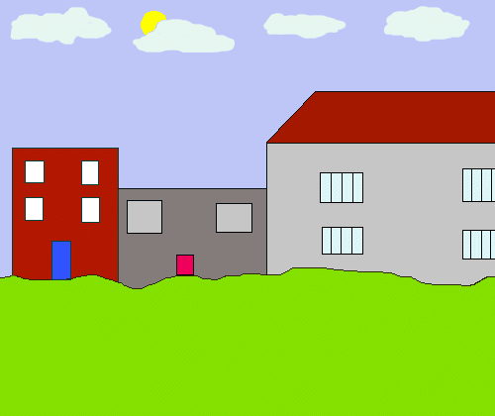
Background Model
After Background Filtering…

Slide 6
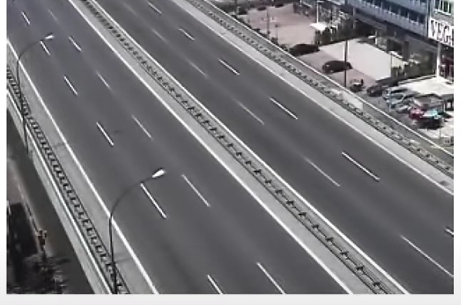
PROBLEM
Frame at Time: t
[12, 25, 12, 45]
[12, 125, 17, 14]
[18, 184, 15, 126]
[18, 25, 214, 65]

Slide 7
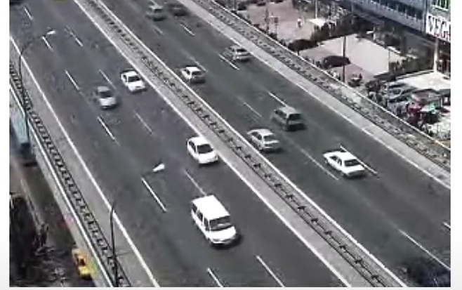
Frame at Time: t+1
[12, 25, 12, 45]
[12, 125, 125, 14]
[18, 15, 184, 126]
[18, 25, 214, 65]

Slide 8
Time: t+1 - t
12-12 | 25-25 | 12-12 | 45-45
0 | 0 | 0 | 0
12-12 | 125-125 | 17-17 | 14-14
0 | 0 | 0 | 0
18-18 | 15-184 | 184-15 | 126-126
0 | 169 | 169 | 0
18-18 | 25-25 | 214-214 | 65-65
0 | 0 | 0 | 0

Slide 9
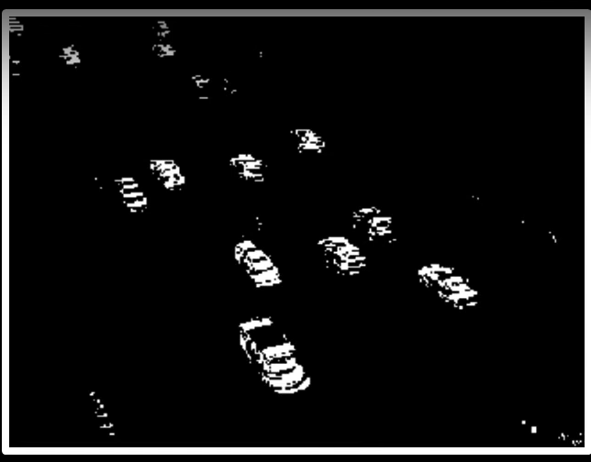
Result (t+1 - t)
[0 , 0 , 0 , 0]
[0 , 0 , 0, 0]
[0, 169, 169, 0]
[0 , 0 , 0,0]

Slide 10
Frame differencing
Background is estimated to be the previous frame:
B(x, y, t) = I(x, y, t - 1)
Background subtraction then becomes:
|I(x, y, t) - I(x, y, t - 1)| > Th

Slide 11
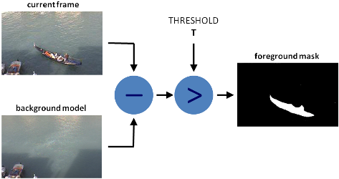
Background subtraction (BS) is a common and widely used technique for generating a foreground mask (namely, a binary image containing the pixels belonging to moving objects in the scene) by using static cameras

Slide 12
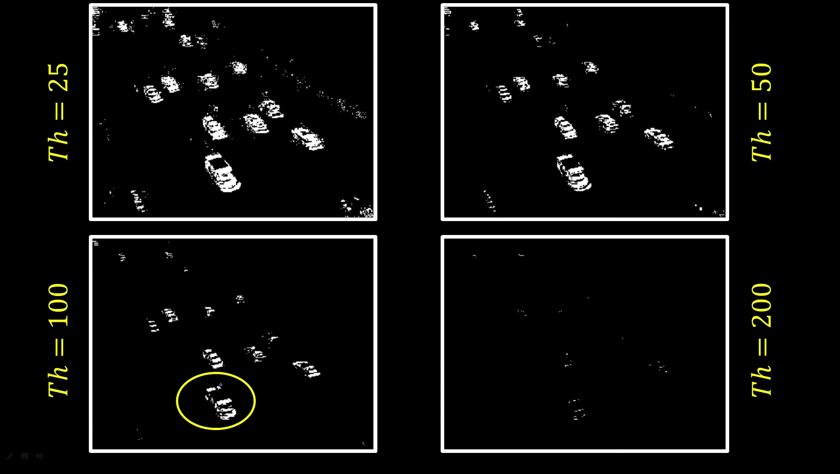

Slide 13
In OpenCV we have 3 algorithms to do this operation
BackgroundSubtractorMOG – It is a Gaussian Mixture-based Background/Foreground Segmentation Algorithm.
BackgroundSubtractorMOG2 – It is also a Gaussian Mixture-based Background/Foreground Segmentation Algorithm. It provides better adaptability to varying scenes due illumination changes etc.
BackgroundSubtractorGMG – This algorithm combines statistical background image estimation and per-pixel Bayesian segmentation.

Slide 14
Advantages
Simple and Efficient
Effective for Static Cameras
Quick Motion Detection
Foreground Isolation
Useful for Object Tracking
Flexible Implementation

Slide 15
Disadvantages:
Sensitive to illumination changes
Fails with shadows and reflections
Background changes slowly (e.g., waving trees)
Requires tuning thresholds for accuracy

Slide 16
How to overcome the disadvantages:
Use adaptive background modeling
Apply shadow removal techniques
Combine with temporal filtering or morphological operations
Use advanced models (e.g., Mixture of Gaussians)

Slide 17


